Slide 1
University of Basrah Al-zahraa medical college
Ministry of higher Education and Scientific Researches
The module: URINARY SYSTEM MODULE
Session 4 Lecture 1
MODULE STAFF:
Prof.Mahmood Shakir Dr.Adnan Othafa Ass.Prof.Firas Shakir Dr. Safaa Almatook Dr.Khaldoon Sadek
PLASMA VOLUME
For more detailed instruction, any question, cases need help please post to the group of session.
Clinically Orientated Anatomy Moore KL ,DalleyAF&Agur AMR
Publisher:Lippincott Williams and Wilkins:Seventh Edition: ISBN:9781451184471

Slide 2
University of Basrah Al-zahraa medical college
Ministry of higher Education and Scientific Researches
Learning out come
1-Fluid compartments
2-contrle sodium ion in ECF
3-renal response to ECF volume change
For more detailed instruction, any question, cases need help please post to the group of session.

Slide 3
The body fluid is divided in to main compartments intracellular ICF and extracellular compartment ECF ,which in turn divide into interstitial and blood plasma.ECF is about 20% of 70 kg body weight i.e 14 L,11 L in the interstitial comp. and 3 L as plasma
University of Basrah Al-zahraa medical college
Ministry of higher Education and Scientific Researches
LO1
For more detailed instruction, any question, cases need help please post to the group of session.

Slide 4
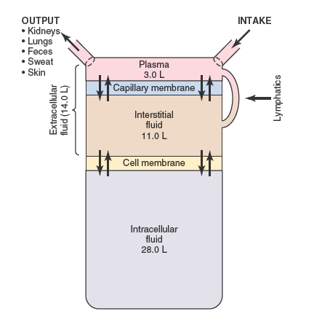
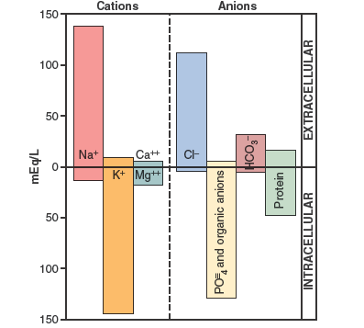
University of Basrah Al-zahraa medical college
LO2
For more detailed instruction, any question, cases need help please post to the group of session.

Slide 5
Composition ECF both plasma and interstitial fluid have the same ionic components since the separation is by highly permeable membrane the difference is in the presence of proteins in plasma main ionic electrolyte include sodium and chloride ICF in contrast to ECF has small amount of NaCl but contain potasium and phosphate almost no calcium ,magnisium ,sulfates and proteins
University of Basrah Al-zahraa medical college
Ministry of higher Education and Scientific Researches
LO2
For more detailed instruction, any question, cases need help please post to the group of session.

Slide 6
Renal Sodium handling Na is the main ion of ECF ,main osmotic load, so it is the main determinant of volume thus kidney control of Na can control plasma volume
University of Basrah Al-zahraa medical college
Ministry of higher Education and Scientific Researches
LO2
For more detailed instruction, any question, cases need help please post to the group of session.

Slide 7
Na ion balance if ingestion more than loss ----increase ECF because of decreae in fluid loss by nephron result in increase blood pressure if increase in Na loss more than intake it will lead to more loss of fluid by nephron it will lead to reduction of ECF and decrease blood pressure due to decrease plasma volume
University of Basrah Al-zahraa medical college
Ministry of higher Education and Scientific Researches
LO2
For more detailed instruction, any question, cases need help please post to the group of session.

Slide 8
How dose the body sense change in plasma volume? Baroreceptors: 1-low pressure receptors in the atria*bainbridge reflex 2-high pressure receptors in the aortic arch and carotid sinus Flow receptors at the macula densa Osmorecptors:with increase osmosis due to high Na the body secrete ADH to reabsorb water to regain osmotic balance
University of Basrah Al-zahraa medical college
Ministry of higher Education and Scientific Researches
LO2
For more detailed instruction, any question, cases need help please post to the group of session.

Slide 9
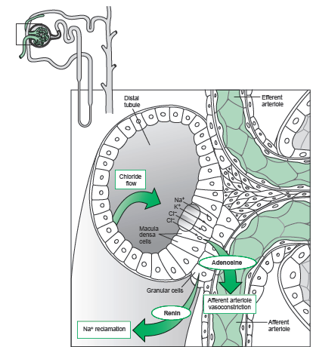
University of Basrah Al-zahraa medical college
Ministry of higher Education and Scientific Researches
LO2
For more detailed instruction, any question, cases need help please post to the group of session.

Slide 10
Summery renal response to plasma volume is by: if the ECF volume increase it excrete more NaCl if the ECF volume decrease it decrease the excretion of NaCl
University of Basrah Al-zahraa medical college
Ministry of higher Education and Scientific Researches
LO2
For more detailed instruction, any question, cases need help please post to the group of session.

Slide 11
Sodium handling by the nephron 67% reabsorbed in PCT 25% in the loop of Henle Na-K-ATP pump pump Na from cell to interstiatial space by active transpor in exchange fo K as a result Na pass from tubular lumen to the cell passivly
University of Basrah Al-zahraa medical college
Ministry of higher Education and Scientific Researches
LO2
For more detailed instruction, any question, cases need help please post to the group of session.

Slide 12
Renin system RAA decrease flow in the tubule stimulate macula densa to secrete renin with cosequence of angiotensin and sodium reabsorption Natriuretic peptides it is secreted in response to pressure change in the heart leading to increase sodium excretion and increse GFR
University of Basrah Al-zahraa medical college
Ministry of higher Education and Scientific Researches
LO2
For more detailed instruction, any question, cases need help please post to the group of session.

Slide 13
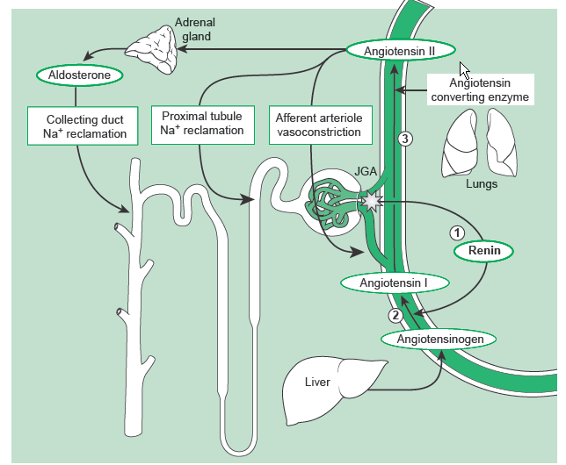
University of Basrah Al-zahraa medical college
Ministry of higher Education and Scientific Researches
LO2
For more detailed instruction, any question, cases need help please post to the group of session.

Slide 14
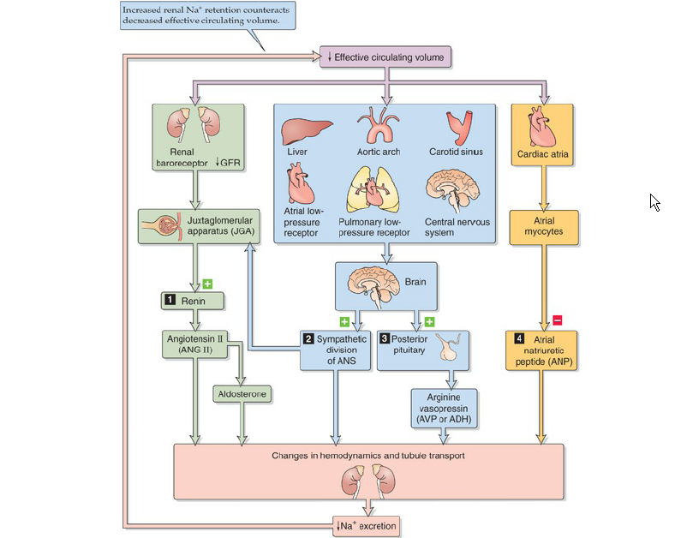
University of Basrah Al-zahraa medical college
Ministry of higher Education and Scientific Researches
LO2
For more detailed instruction, any question, cases need help please post to the group of session.

Slide 15
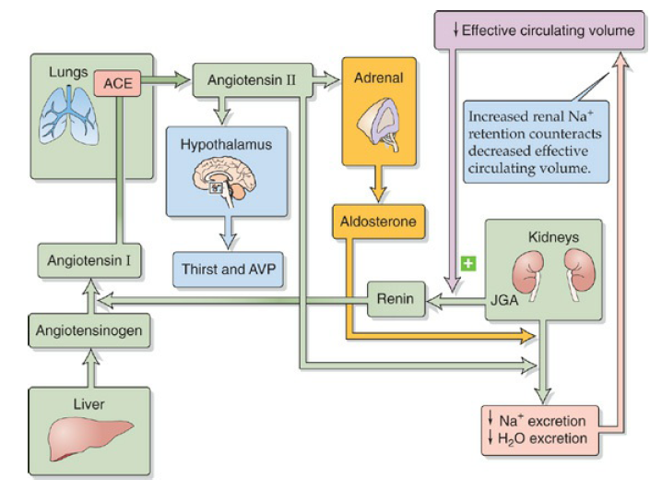
University of Basrah Al-zahraa medical college
Ministry of higher Education and Scientific Researches
LO2
For more detailed instruction, any question, cases need help please post to the group of session.

Slide 16
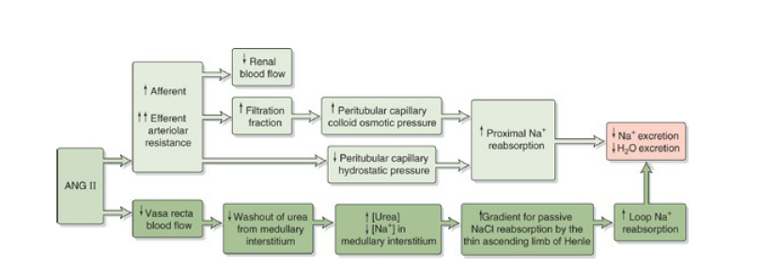
University of Basrah Al-zahraa medical college
Ministry of higher Education and Scientific Researches
LO2
For more detailed instruction, any question, cases need help please post to the group of session.

Slide 17
University of Basrah Al-zahraa medical college
Ministry of higher Education and Scientific Researches
LO2
For more detailed instruction, any question, cases need help please post to the group of session.

Slide 18
University of Basrah Al-zahraa medical college
Ministry of higher Education and Scientific Researches
LO2
For more detailed instruction, any question, cases need help please post to the group of session.

Slide 19
University of Basrah Al-zahraa medical college
Ministry of higher Education and Scientific Researches
For more detailed instruction, any question, cases need help please post to the group of session.

Slide 20
University of Basrah Al-zahraa medical college
Ministry of higher Education and Scientific Researches
For more detailed instruction, any question, cases need help please post to the group of session.

